Slide 1

Emotion and Affective Computing (Chapter 23) Lecture 5-6

Slide 2
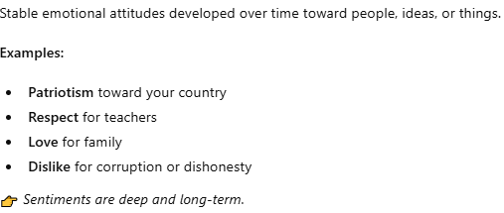
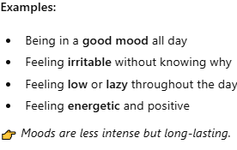
Introduction
Affect
Emotions, feelings, moods, sentiments
Basic emotions
Fear, anger, surprise
Long-term emotions
Love, jealousy
Person’s level of arousal and stress
Affective computing

Slide 3
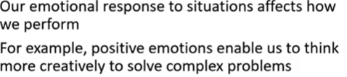
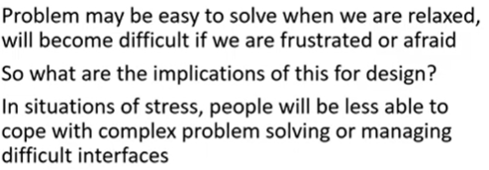
How these affects.

Slide 4

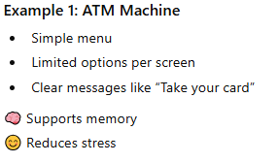

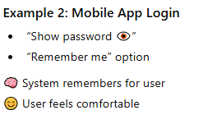
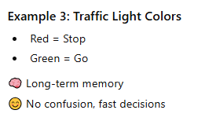

Slide 5
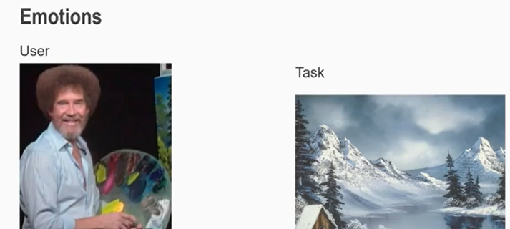
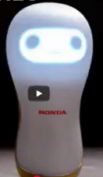
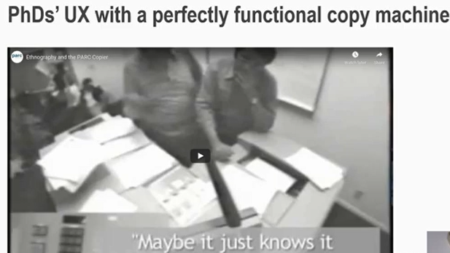
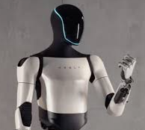

Slide 6
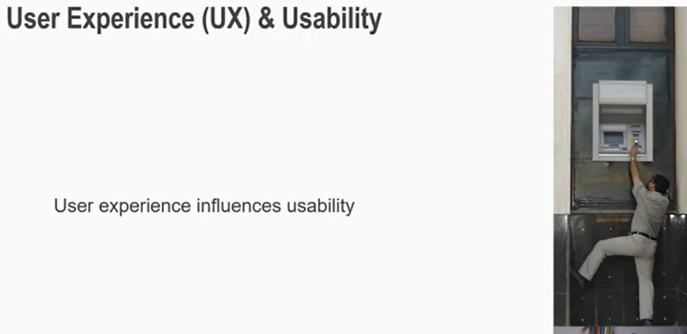
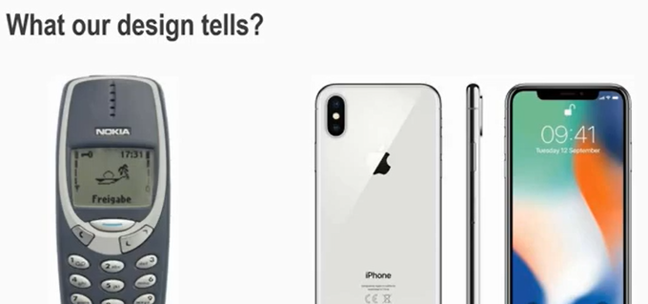

Slide 7
Psychological Theories of Emotion
Basic emotions
Fear, surprise, disgust, anger, happiness, and sadness
Universal – recognized and expressed in the same way
Facial Action Coding System (FACS) – Ekman and Friesen, 1978
FACS is a comprehensive, anatomically-based system for describing all visually discernible facial movements in terms of Action Units (AUs). Originally developed by Paul Ekman and Wallace V. Friesen (1978), it has become the gold standard in facial behavior analysis.
Eight pairs of primary emotions that can be combined to produce secondary emotion – Plutchik (1980)
Pleasure (valence) and arousal – Russel and Fernandez-Dols (1997)

Slide 8
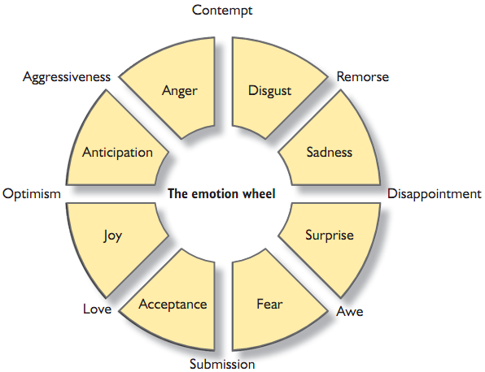
Eight pairs of primary emotions

Slide 9
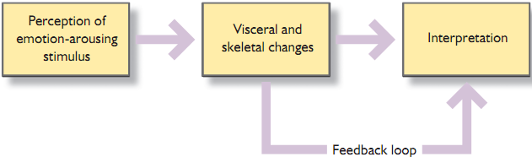
James-Lange theory – 1890s
Action precedes emotions (Sequential)
Events/Actions/Incidents/Accidents……
Physiological Response/Reaction……….
Interpretation…….Making Sense
Result: Emotion, its type and level

Slide 10
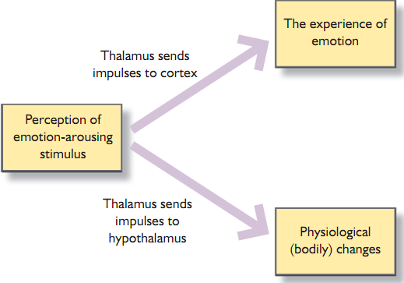
The Cannon-Bard theory – 1920s
Actions follow from cognitive appraisal (Parallel)
Events/Actions/Incidents/Accidents….
Physiological Response/Reaction……….
Interpretation……Making Sense…….
Result: Emotion, its type and level

Slide 11
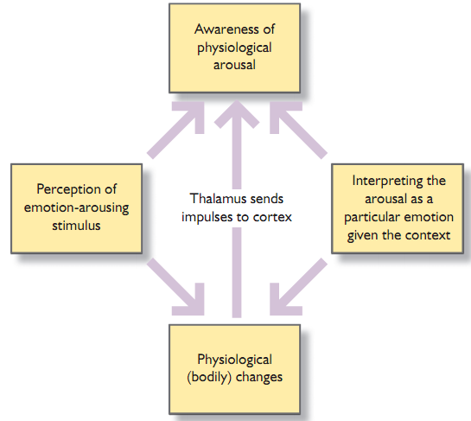
Schacter-Singer – 1960s
Emotion is the result of evaluation of physiological responses in the context
Events/Incidents in a Context
Physiological and Cognitive Response
Identifying Reasons based on events and
responses in a situation simultaneously
Interpretation……Making Sense…….
Result: Emotion, its type and level

Slide 12
Implications
“Negative affect can make it harder to do even easy tasks; positive affect can make it easier to do difficult tasks” (Donald Norman)
Stress will increase the difficulty of problem solving
Relaxed users will be more forgiving of shortcomings in design
Aesthetically pleasing and rewarding interfaces will increase positive affect
Source: HCI, A. Dix et al., 3rd Ed. P. 52

Slide 13
Detecting and Recognizing Emotions
Apparent to other people
Facial expression, voice intonation, gesture, movement, posture, pupillary dilation
Less apparent to other people
Respiration, heart rate, pulse, temperature, electro dermal response, perspiration, blood pressure
Challenges: detecting changes and attributing them to the correct emotion

Slide 14
Basic Steps to Recognize Emotions
Input
Receiving a variety of input signals
Pattern recognition
Performs feature extraction and classification on these signals
Reasoning
Predicts underlying emotion based on knowledge about how emotions are generated and expressed
Learning
As the computer ‘gets to know’ someone, it learns which of the above factors are most important for that individual
Bias
The emotional state of the computer
Output
The computer names (or describes) the recognized expressions and the likely underlying emotion

Slide 15
Some Issues
Good progress so far
Sensors and software are available to detect physiological changes
Sensors themselves are too intrusive or awkward
The data requires expert analysis or intelligent systems
The same combinations of physiological signs can belong to different emotions e.g. the signs of disgust and amusement are very similar
The need for the detection of other physical signs and/or pattern recognition

Slide 16
Examples
StartleCam (1999)
System to recognize eight emotions (Picard et al., 2001)
Face tracking systems
Healthcare systems
Earring for blood pressure
‘6th sense’ – a light sculpture

Slide 17
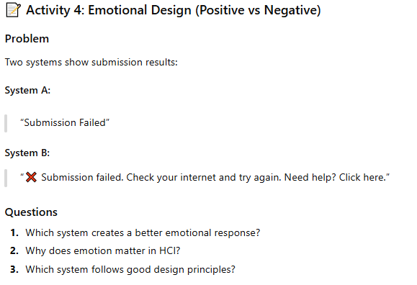

Slide 18
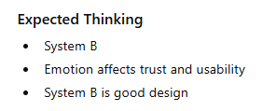

Slide 19
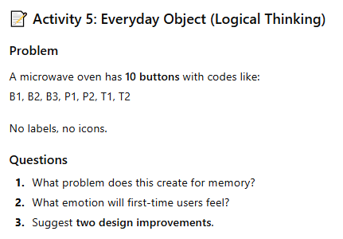

Slide 20
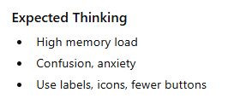

Slide 21
